Slide 1



Setting educational assessment standards
Research on Standards in GCSEs in Wales Project, funded by Qualifications Wales (2024)

Slide 2
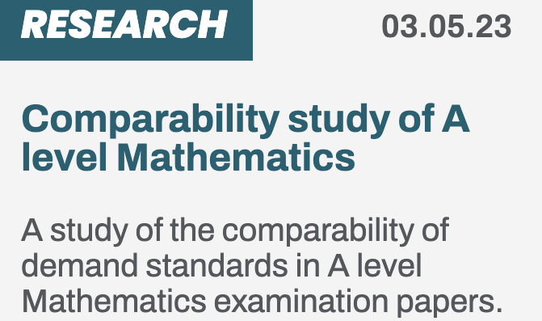



Setting educational assessment standards
Jo-Anne Baird
Oxford University Centre for Educational Assessment

Slide 3
In This lecture SERIES we consider
What are standards & what are qualification standards?
Three different ways to think about assessments – assessment paradigms
How standards differ in philosophy & method in these paradigms

Slide 4
Three paradigms of assessment
Apprenticeships
Vocational qualifications
Outcomes-based
Examinations
Classroom assessment
GCSEs
Curriculum-based
Construct-based
Intelligence tests
Personality tests
psychometrics
Baird, J. and Opposs, D. (2018). Chapter 1 - The Standard Setting Project: assessment paradigms. In Baird, J., Isaacs, T., Opposs, D. and Gray, L. (Editors) Examination standards: How measures and meanings differ around the world.. UCL IOE Press. 2 – 25.
Notes:
History of each – different actors with different purposes. Priorities shaped the philosophy, methods and interpretation.

Slide 5
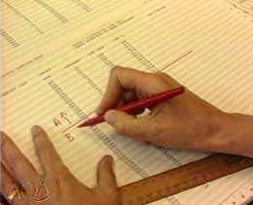
Curriculum-based assessment
Attribute: what is the nature of the thing you are trying to assess?
Attainment
Common assessment formats
Examinations including extended answers
Coursework

Slide 6
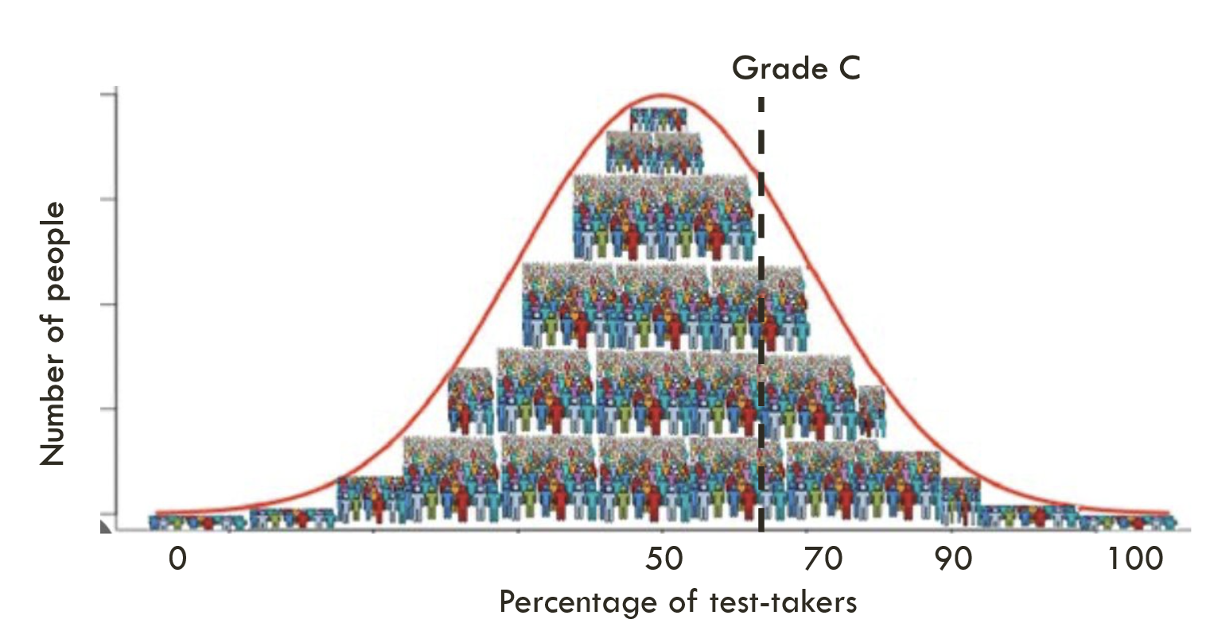
Curriculum-based assessment
Prototypical definition of standards
Results distribution expectations
Grade B
Attainment referencing
Grades that grades that reflect holistic attainment in the qualification at a standard which is comparable with the attainment required for that outcome in the previous years’ qualification

Slide 7
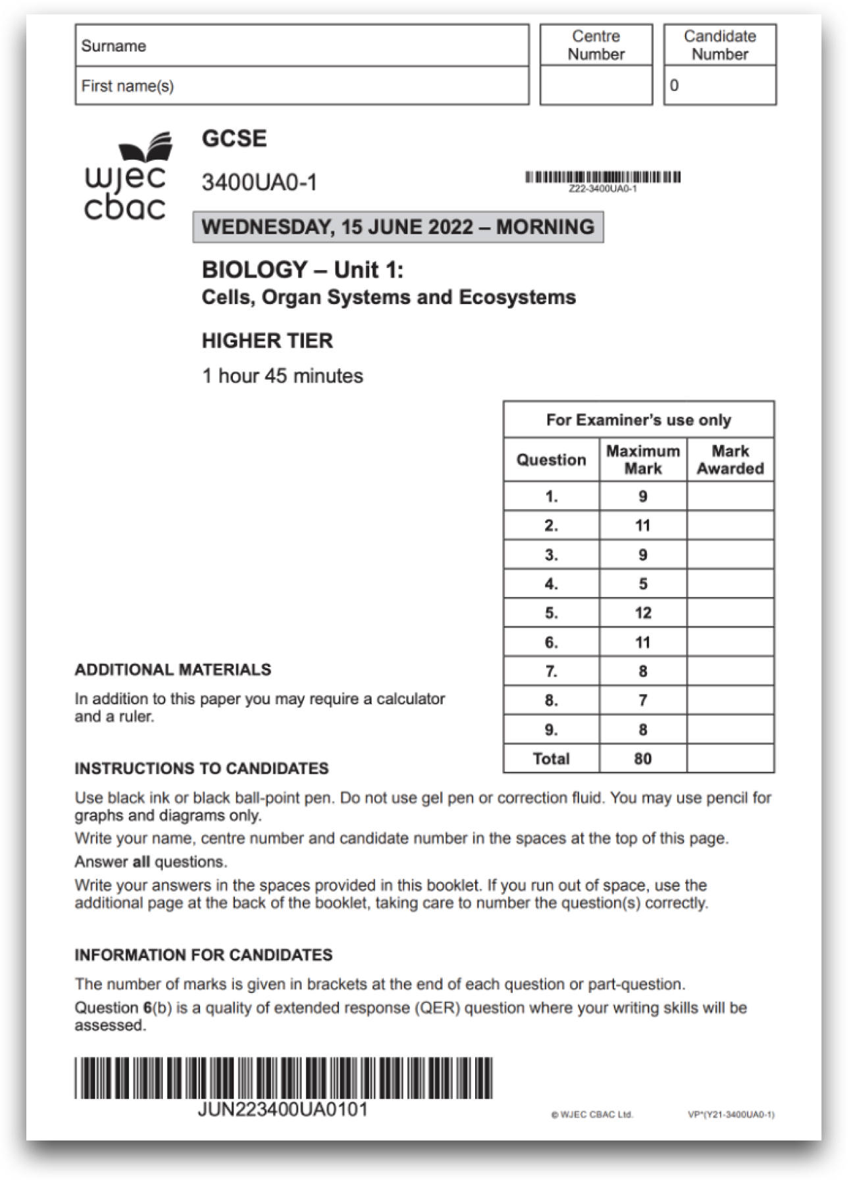
Curriculum-based example
Emphasis on quantitative data when the entry figures are larger and qualitative information when there is a smaller cohort
% gaining a grade C or above

Slide 8
Debates on curriculum-based assessment
Dominance of testing over teaching and learning
Standards over time
Comparability of different subjects
Inter-rater reliability
Changes to curriculum
Relationship with school accountability – effects on institutional behaviours

Slide 9
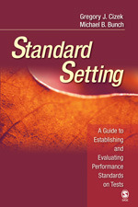
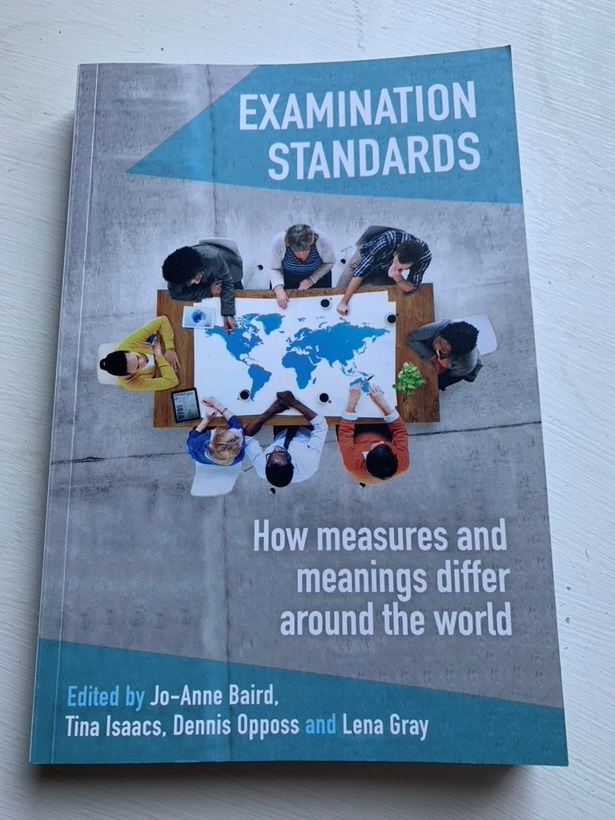
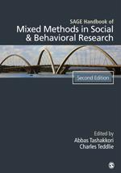
Additional references used in this lecture
Cizek, G., & Bunch, M. (2007). Standard Setting. SAGE Publications. https://doi.org/10.4135/9781412985918
Baird, J., Isaacs, T., Opposs, D. & Gray, L. (2018). Examination Standards: How Measures and Meanings Differ Around the World. UCL IOE Press.
Tashakkori, A. and Teddlie, C. (Editors) (2010) SAGE Handbook of Mixed Methods in Social and Behavioural Research. 2nd Edition. Thousand Oaks, California: Sage Publications.

Slide 10
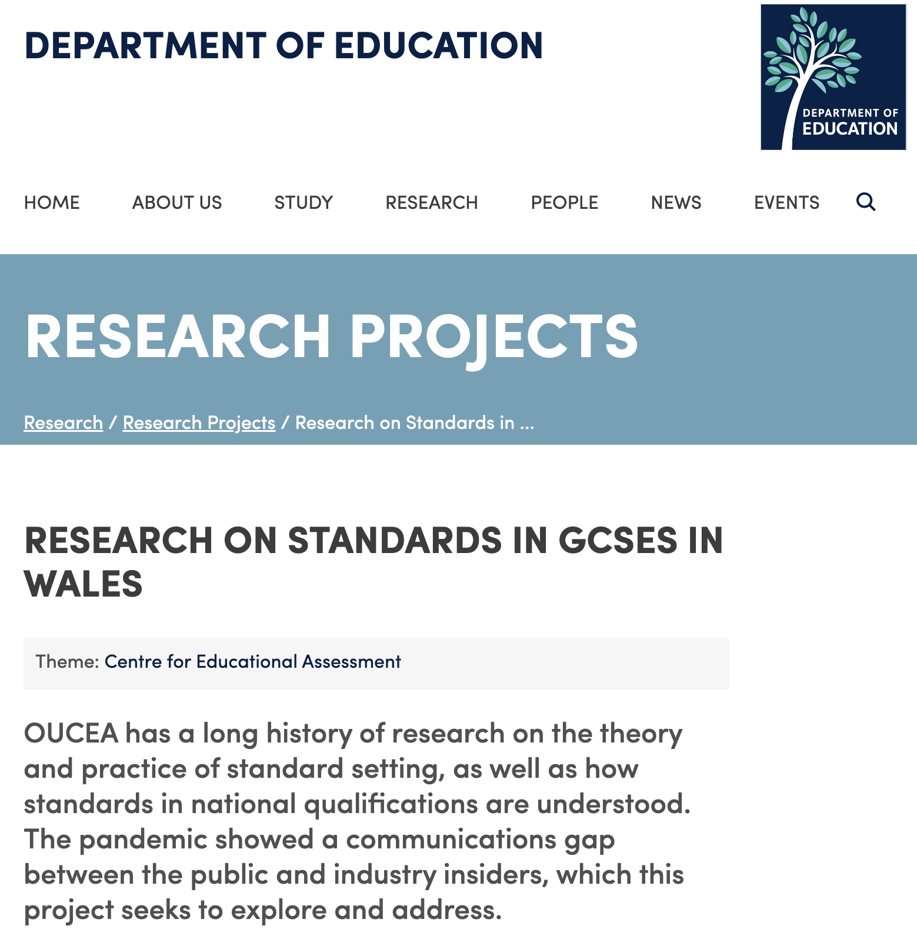

FIND OUT MORE
Oxford University Centre for Educational Assessment (OUCEA)
https://www.education.ox.ac.uk/research/research-on-standards-in-gcses-in-wales/
Home of the

