Slide 1
Setting educational assessment standards
Research on Standards in GCSEs in Wales Project, funded by Qualifications Wales (2024)

Slide 2
Setting educational assessment standards
Jo-Anne Baird
Oxford University Centre for Educational Assessment

Slide 3
In This lecture SERIES we consider
What are standards & what are qualification standards?
Three different ways to think about assessments – assessment paradigms
How standards differ in philosophy & method in these paradigms

Slide 4
Three paradigms of assessment
Apprenticeships
Vocational qualifications
Outcomes-based
Examinations
Classroom assessment
GCSEs
Curriculum-based
Construct-based
Intelligence tests
Personality tests
psychometrics
Baird, J. and Opposs, D. (2018). Chapter 1 - The Standard Setting Project: assessment paradigms. In Baird, J., Isaacs, T., Opposs, D. and Gray, L. (Editors) Examination standards: How measures and meanings differ around the world.. UCL IOE Press. 2 – 25.
Notes:
History of each – different actors with different purposes. Priorities shaped the philosophy, methods and interpretation.

Slide 5
Construct-based assessment
Attribute: what is the nature of the thing you are trying to assess?
Latent trait
Common assessment formats
Multiple choice test under controlled testing conditions

Slide 6
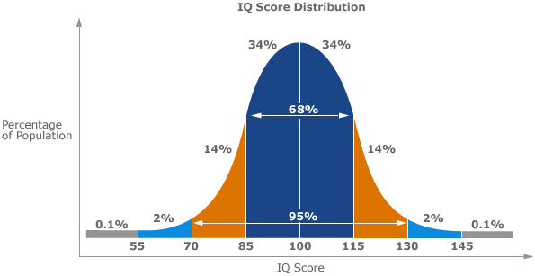
Construct-based assessment
Prototypical definition of standards
Results distribution expectations
Construct referencing
Grades that tell us where the candidates rank in relation to the population of students who could have taken the test in any year with regards to the attribute assessed in the test

Slide 7
Construct-referencing
Examination 1
We know how difficult this is through standard setting
Link
At least some common items and students
Examination 2
Estimate difficulty of this examination
Or design the exam to have particular pass mark
Emphasis on qualitative methods to set standards in initial year
Emphasis on statistical equating to maintain standards

Slide 8
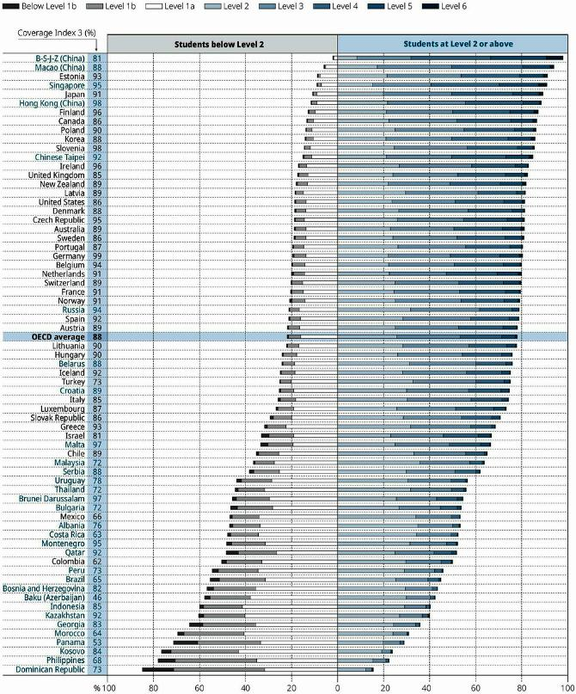
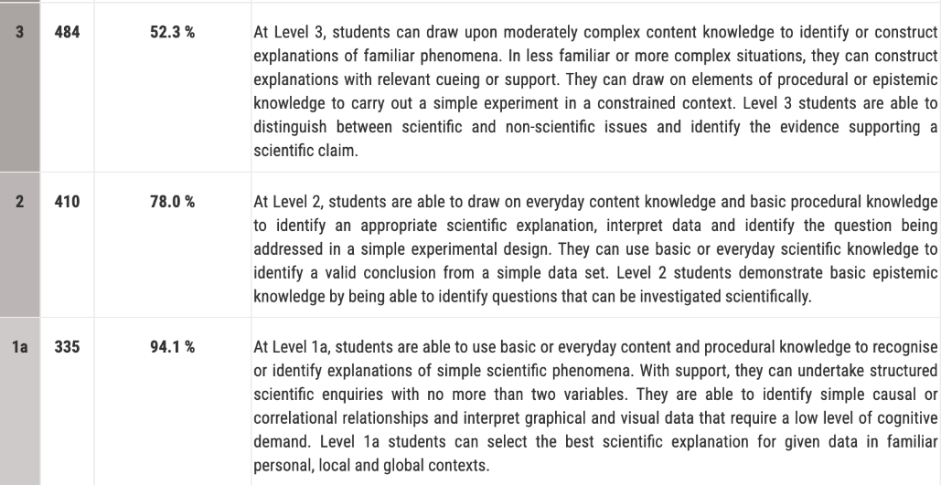
CONSTRUCT-based assessment example
OECD PISA 2018 Science scores
Full scale is from level 1b to 6
https://www.oecd-ilibrary.org/sites/344a8203-en/index.html?itemId=/content/component/344a8203-en

Slide 9
Debates on construct-based assessment
Lack of transparency – complex statistical modelling
Test held securely
Uni-dimensional latent trait (reification)
Multiple choice testing criticized
Complex constructs & difficulty (eg coursework)
Takes no account of effects on preparation
For PISA – comparability of scores across countries

Slide 10
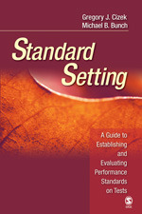
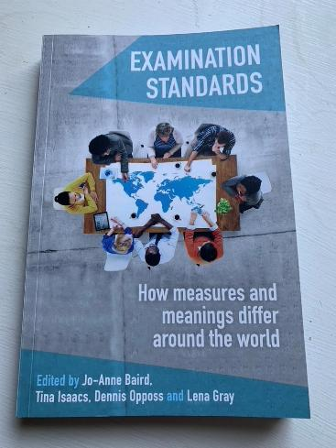
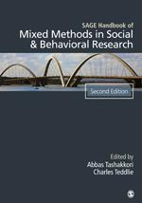
Additional references used in this lecture
Cizek, G., & Bunch, M. (2007). Standard Setting. SAGE Publications. https://doi.org/10.4135/9781412985918
Baird, J., Isaacs, T., Opposs, D. & Gray, L. (2018). Examination Standards: How Measures and Meanings Differ Around the World. UCL IOE Press.
Tashakkori, A. and Teddlie, C. (Editors) (2010) SAGE Handbook of Mixed Methods in Social and Behavioural Research. 2nd Edition. Thousand Oaks, California: Sage Publications.

Slide 11
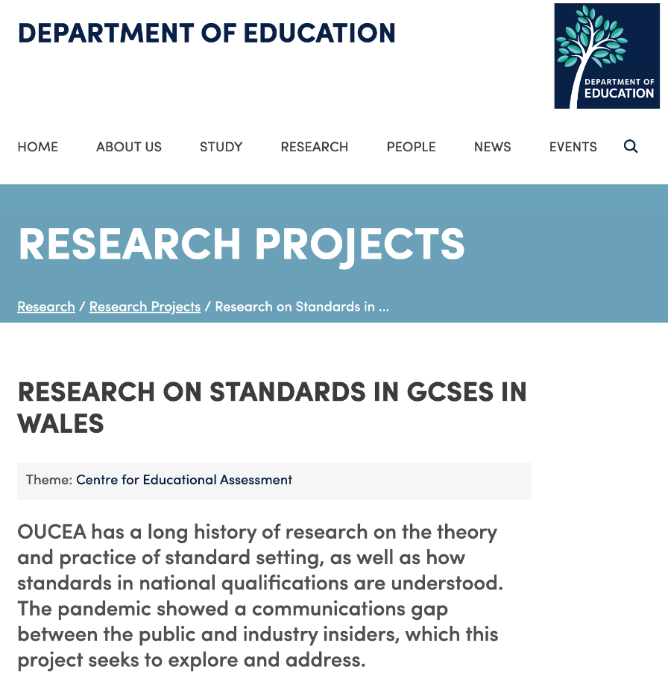
FIND OUT MORE
Oxford University Centre for Educational Assessment (OUCEA)
https://www.education.ox.ac.uk/research/research-on-standards-in-gcses-in-wales/
Home of the

