Slide 1



Setting educational assessment standards
Research on Standards in GCSEs in Wales Project, funded by Qualifications Wales (2024)
Notes:
Standard setting vs maintaining standards

Slide 2
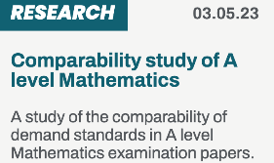



Setting educational assessment standards
Jo-Anne Baird
Oxford University Centre for Educational Assessment

Slide 3
In This lecture SERIES we consider
What are standards & what are qualification standards?
Three different ways to think about assessments – assessment paradigms
How standards differ in philosophy & method in these paradigms

Slide 4
qualification standards ≠ educational standards
Input factors
Pre-school
Child health
Schooling
Attendance
Teacher pay
Output factors
Literacy & numeracy rates
Economically active
Well-being
Progression to Higher Education
Funding per pupil
% GDP on education
Assessment outcomes
Learning at home
Child diet
Pupil : teacher ratio

Slide 5
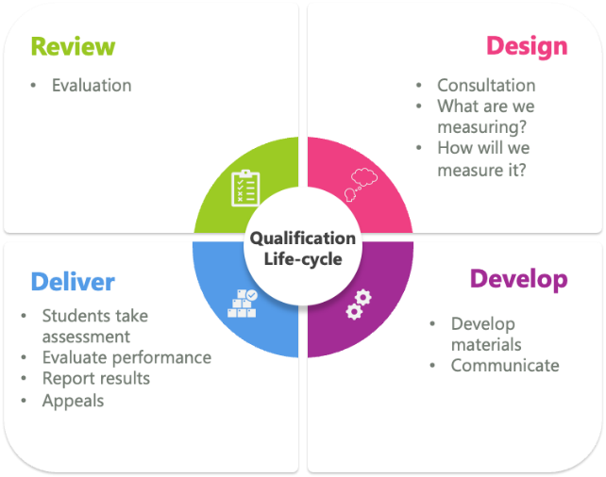

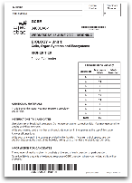
qualification standards: embedded in the qualification lifecycle
Performance standards
Content standards

Slide 6
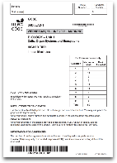

Content
What you have to learn and be able to do
Curriculum
Performance
The level at which you have to perform to get the grade
Boundary marks (cut-scores)
Question papers
Marking schemes
Assessment regulations (eg content coverage)
Produced in the development stage of the qualification lifecycle
Aggregation and resit regulations
Produced in the delivery stage of the qualification lifecycle, during the standard setting process

Slide 7


AWARDING processes
Qualitative data
Quantitative data
Mixed methods
What is the theory?
Which is the core component of data, and which is supplemental?
What is the order of data collection?
How are the data integrated into a decision?
Question papers and mark schemes
Students’ work
Oral reports from the Lead Examiners & Moderators
Numbers & characteristics of candidates
Distribution of scores
Relative difficulty of the questions
Comparisons with outcomes for other qualifications

Slide 8
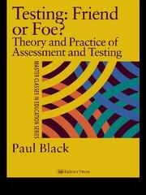
Purposes of assessments
formative, to aid learning
summative for review, transfer and certification, and
summative for accountability to the public
Newton later went on to identify 18 different decision purposes for qualifications
Paul E. Newton (2007) Clarifying the purposes of educational assessment, Assessment in Education: Principles, Policy & Practice, 14:2, 149-170, DOI: 10.1080/09695940701478321
Black, P. J. (1998). Testing: friend or foe? The theory and practice of assessment and testing. London: Falmer Press.

Slide 9
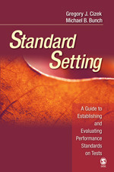
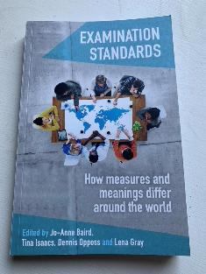
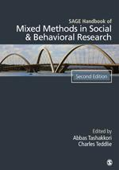
Additional references used in this lecture
Cizek, G., & Bunch, M. (2007). Standard Setting. SAGE Publications. https://doi.org/10.4135/9781412985918
Baird, J., Isaacs, T., Opposs, D. & Gray, L. (2018). Examination Standards: How Measures and Meanings Differ Around the World. UCL IOE Press.
Tashakkori, A. and Teddlie, C. (Editors) (2010) SAGE Handbook of Mixed Methods in Social and Behavioural Research. 2nd Edition. Thousand Oaks, California: Sage Publications.

Slide 10
Next, let’s look at some approaches to assessment
What are standards & what are qualification standards?
Three different ways to think about qualifications – assessment paradigms
How standards differ in philosophy & method in these paradigms

Slide 11
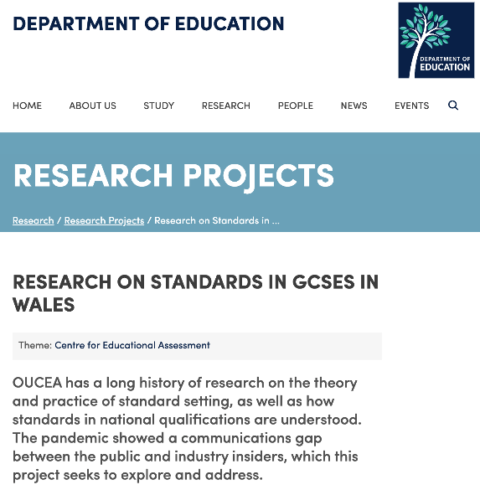

FIND OUT MORE
Oxford University Centre for Educational Assessment (OUCEA)
https://www.education.ox.ac.uk/research/research-on-standards-in-gcses-in-wales/
Home of the

