Slide 1

Faculty of Education and Society
A New Vision for Science in the National Curriculum: How Should the Curriculum Deal with Climate Change?
Michael J. Reiss

Slide 2
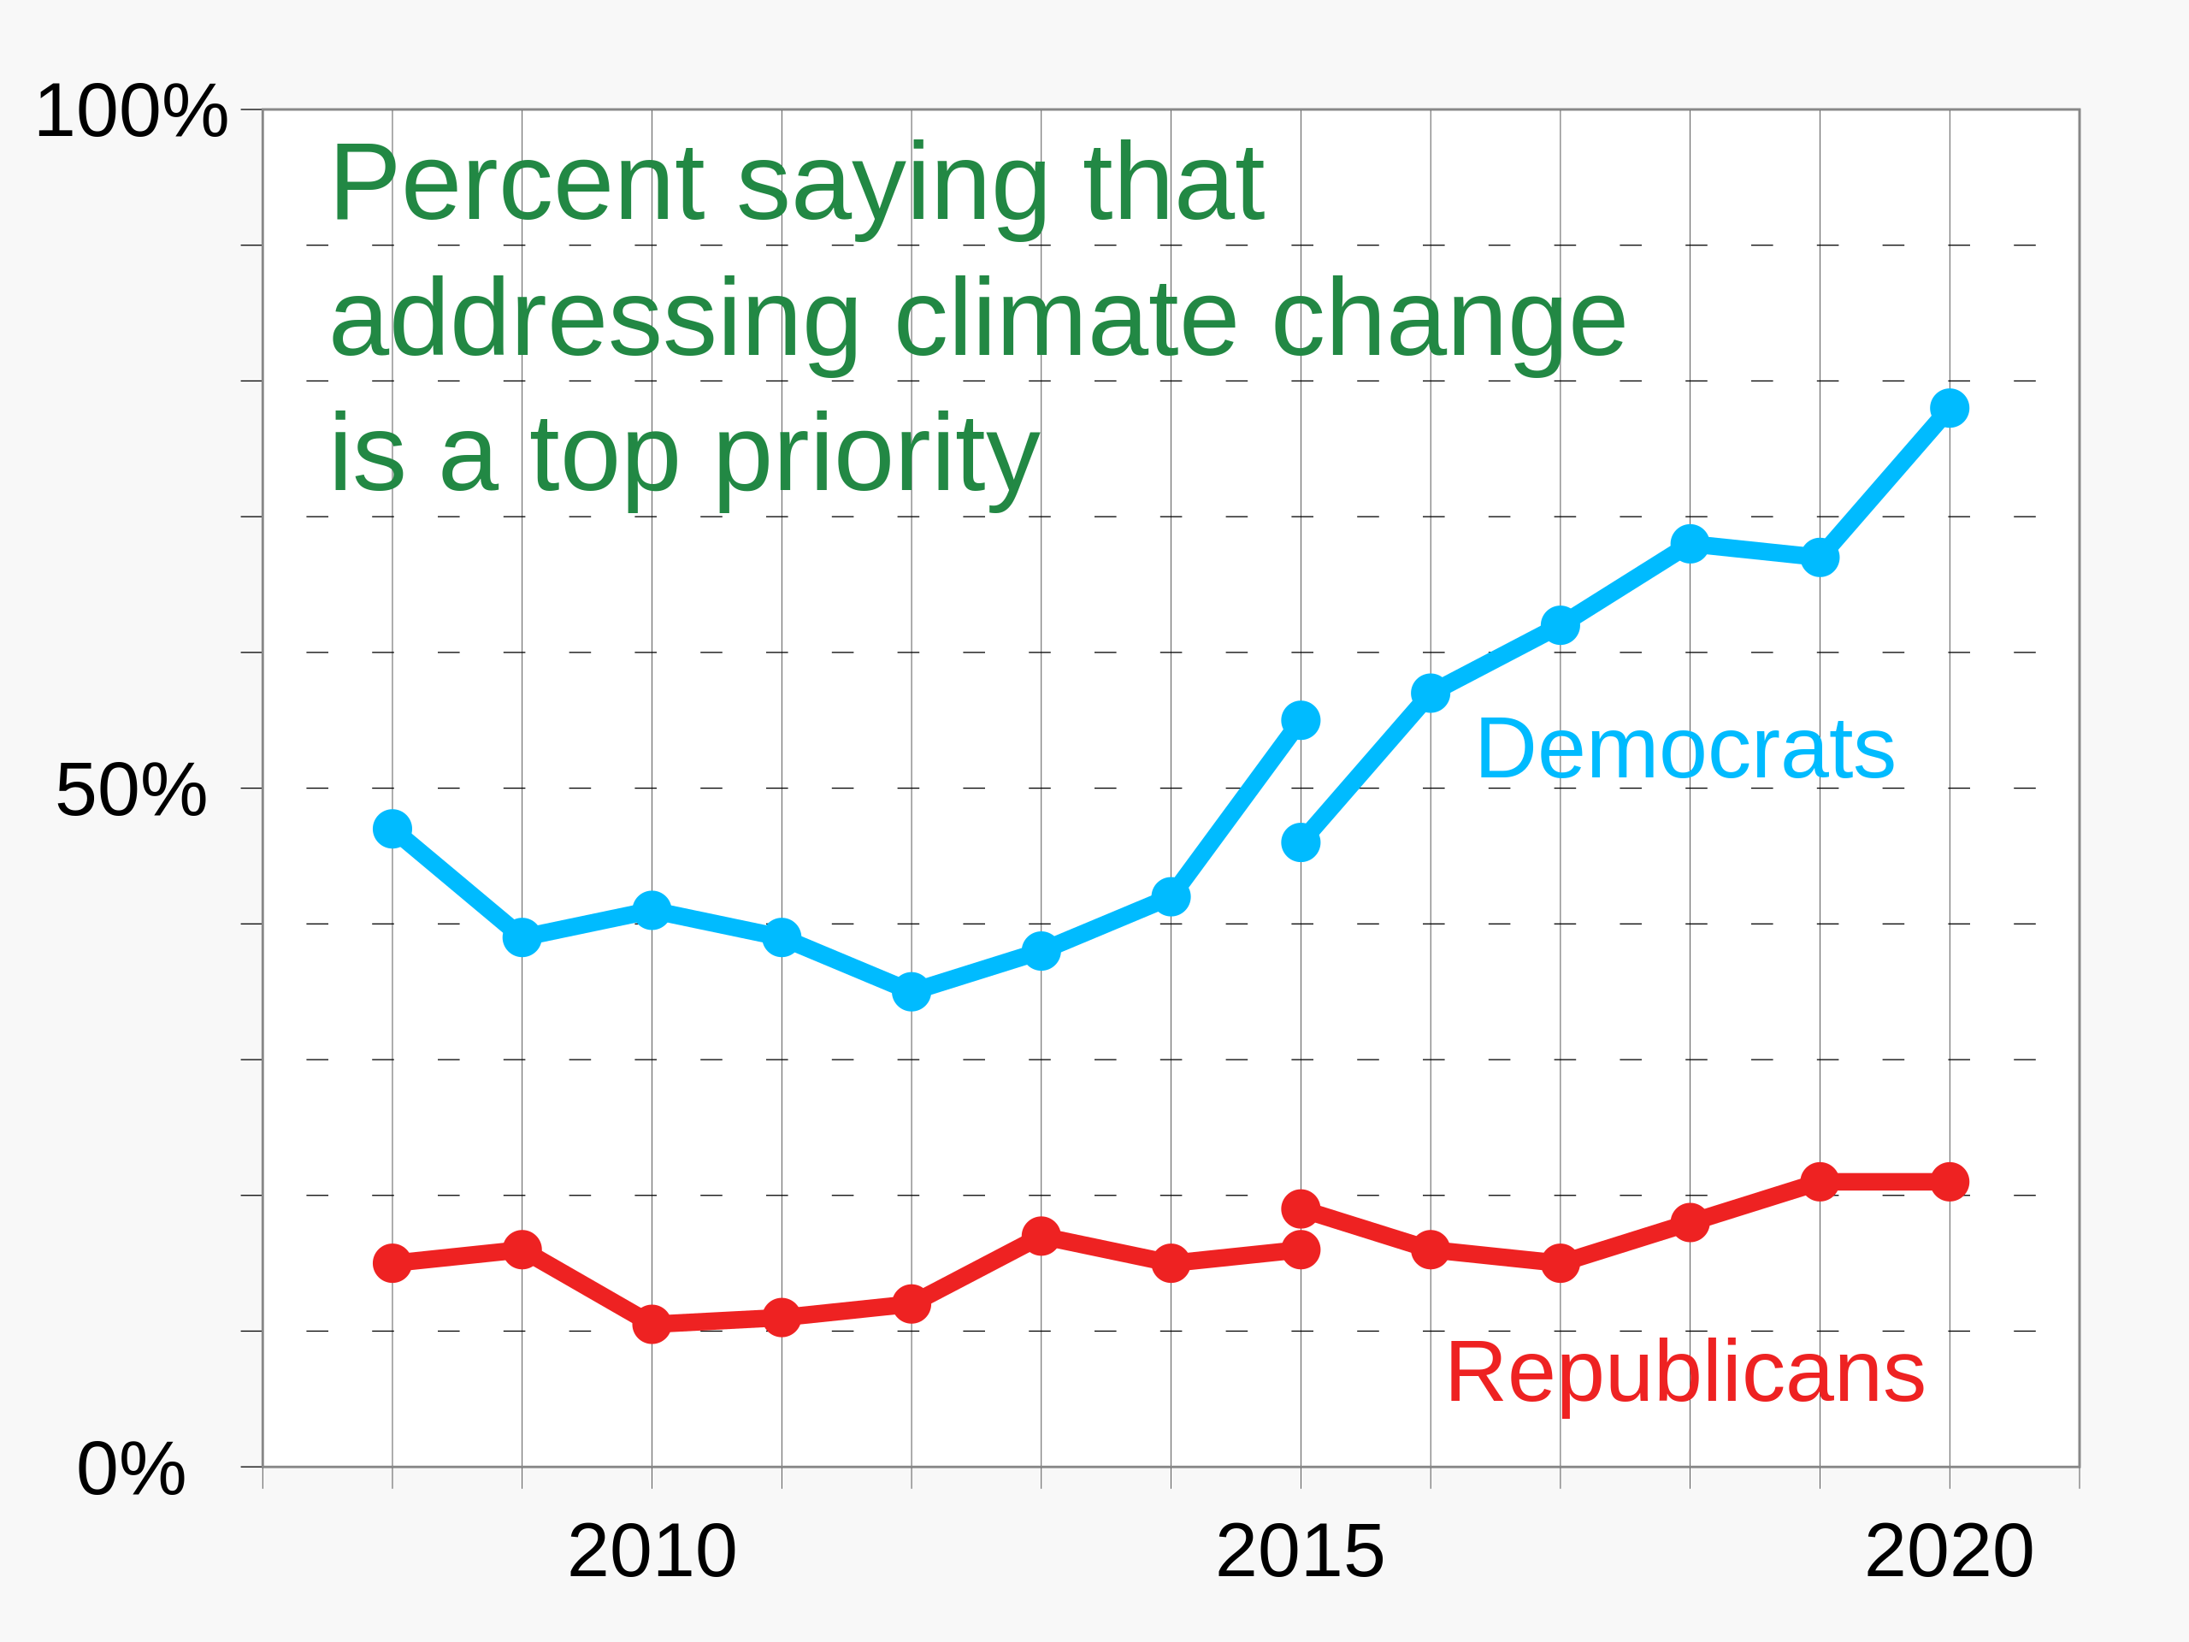
Do we have a climate crisis?

Slide 3
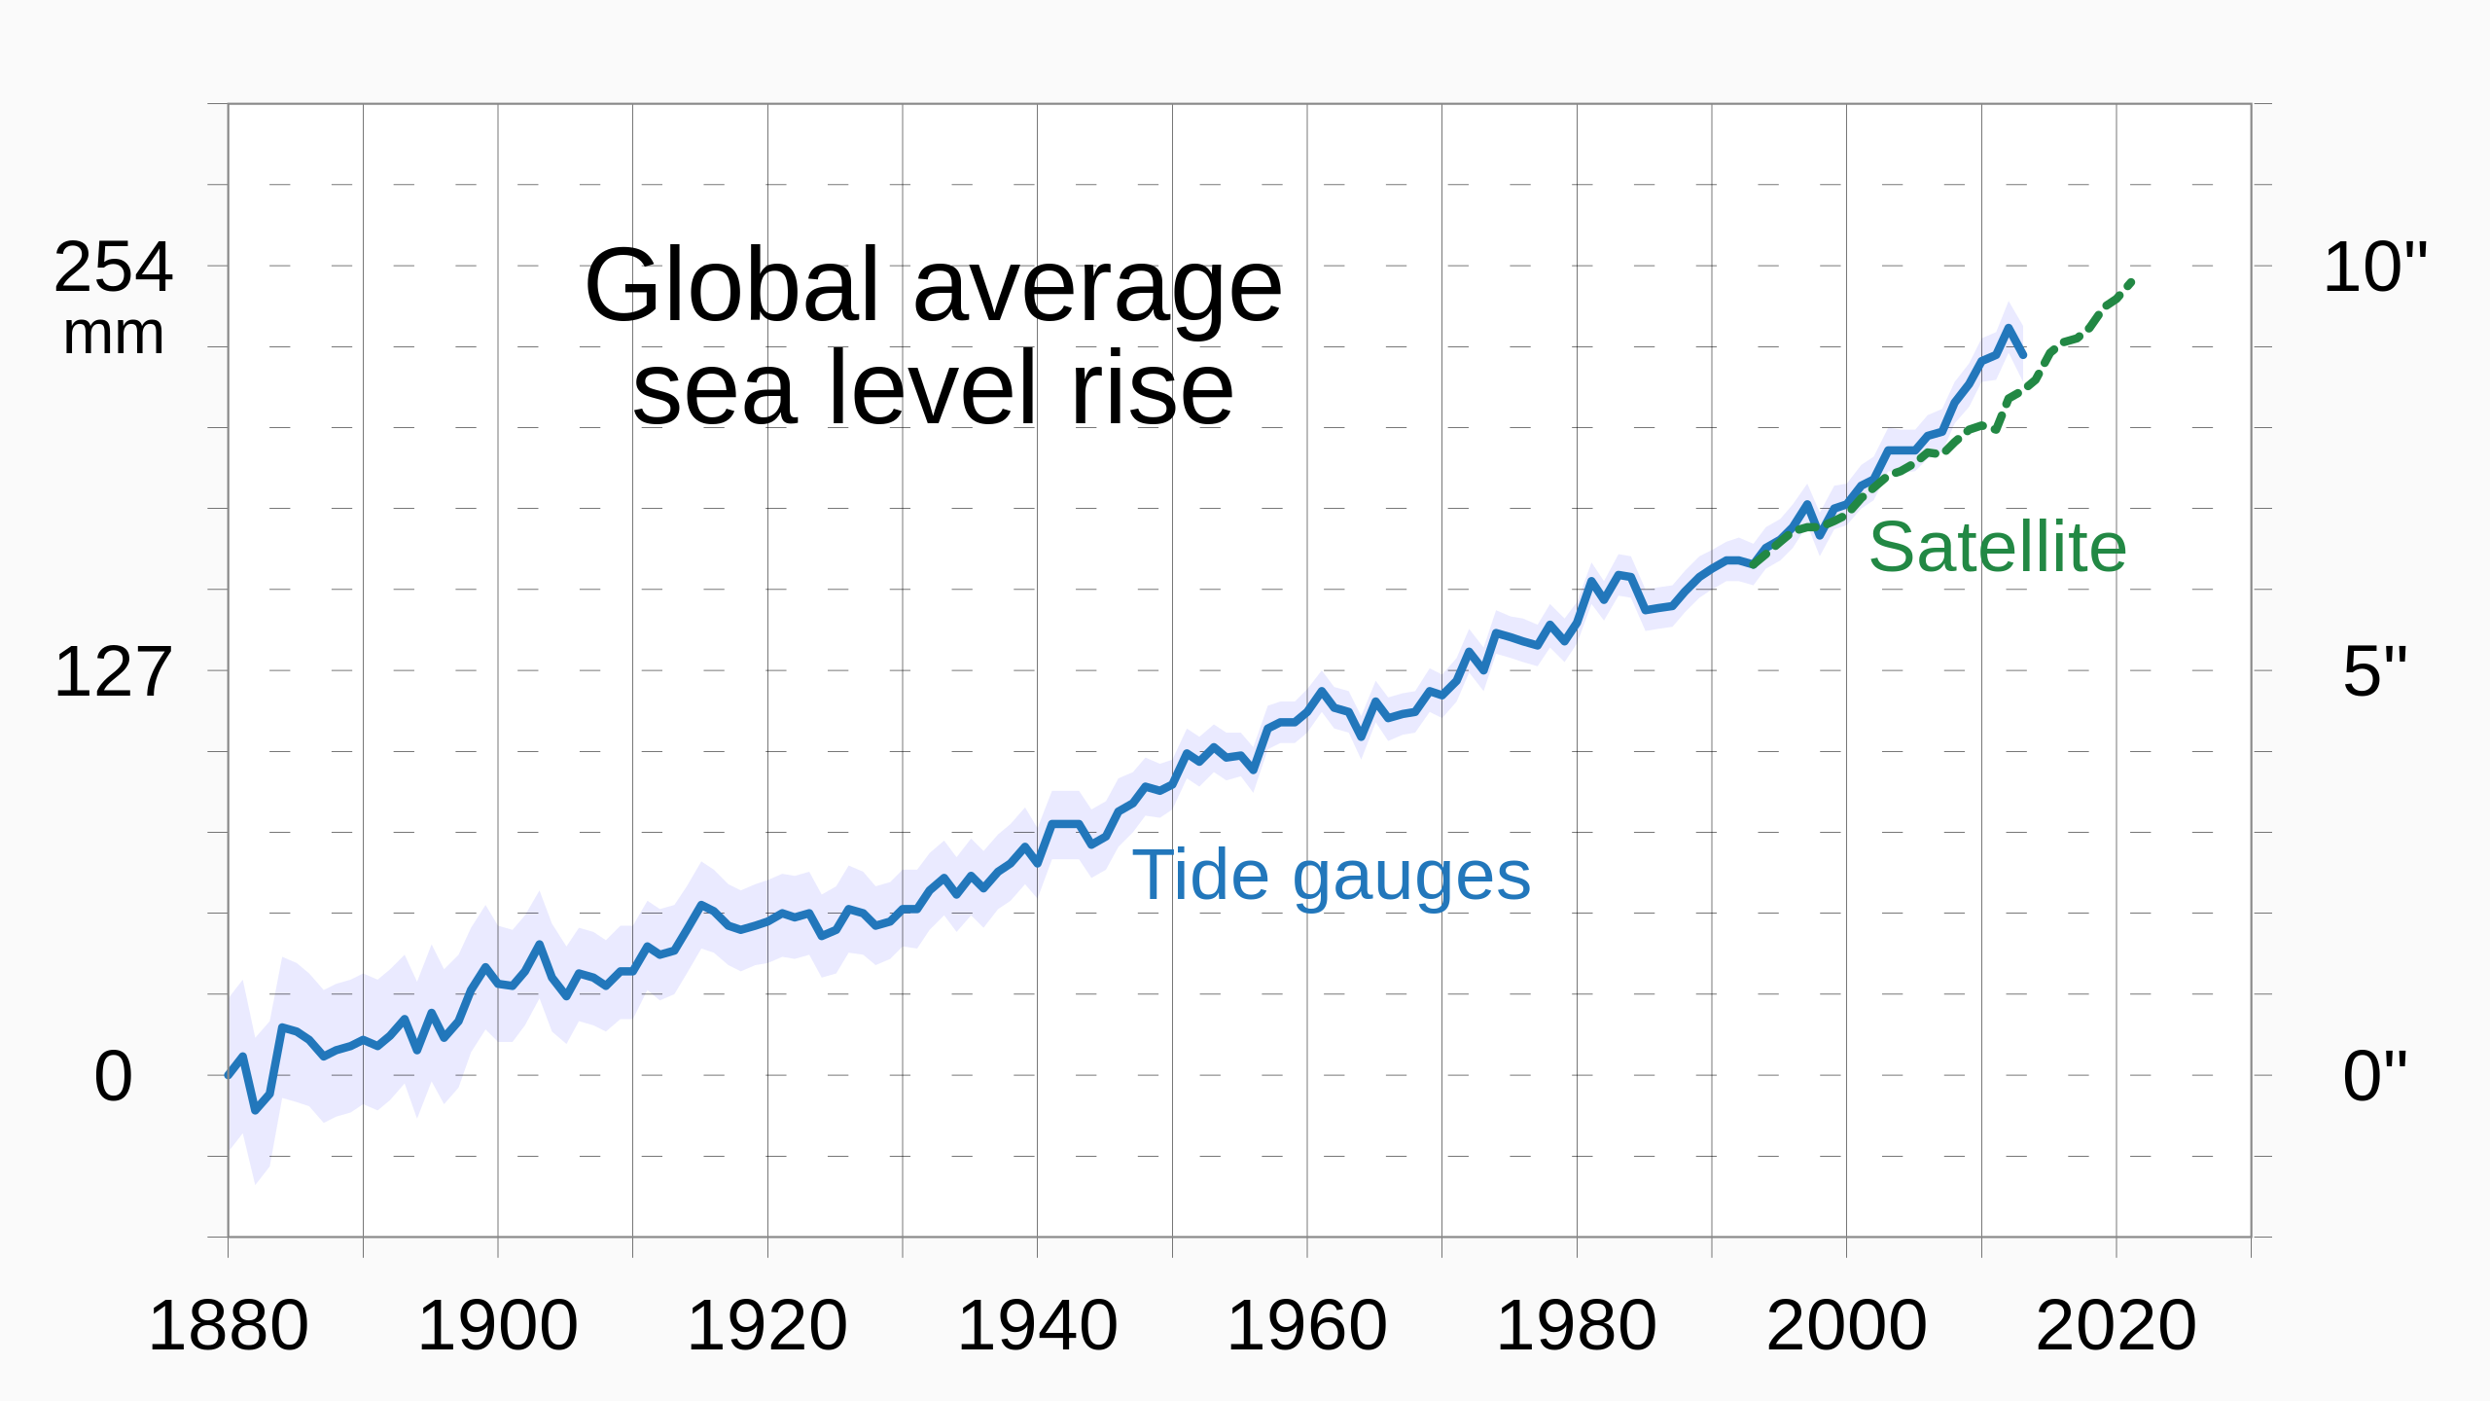

Slide 4
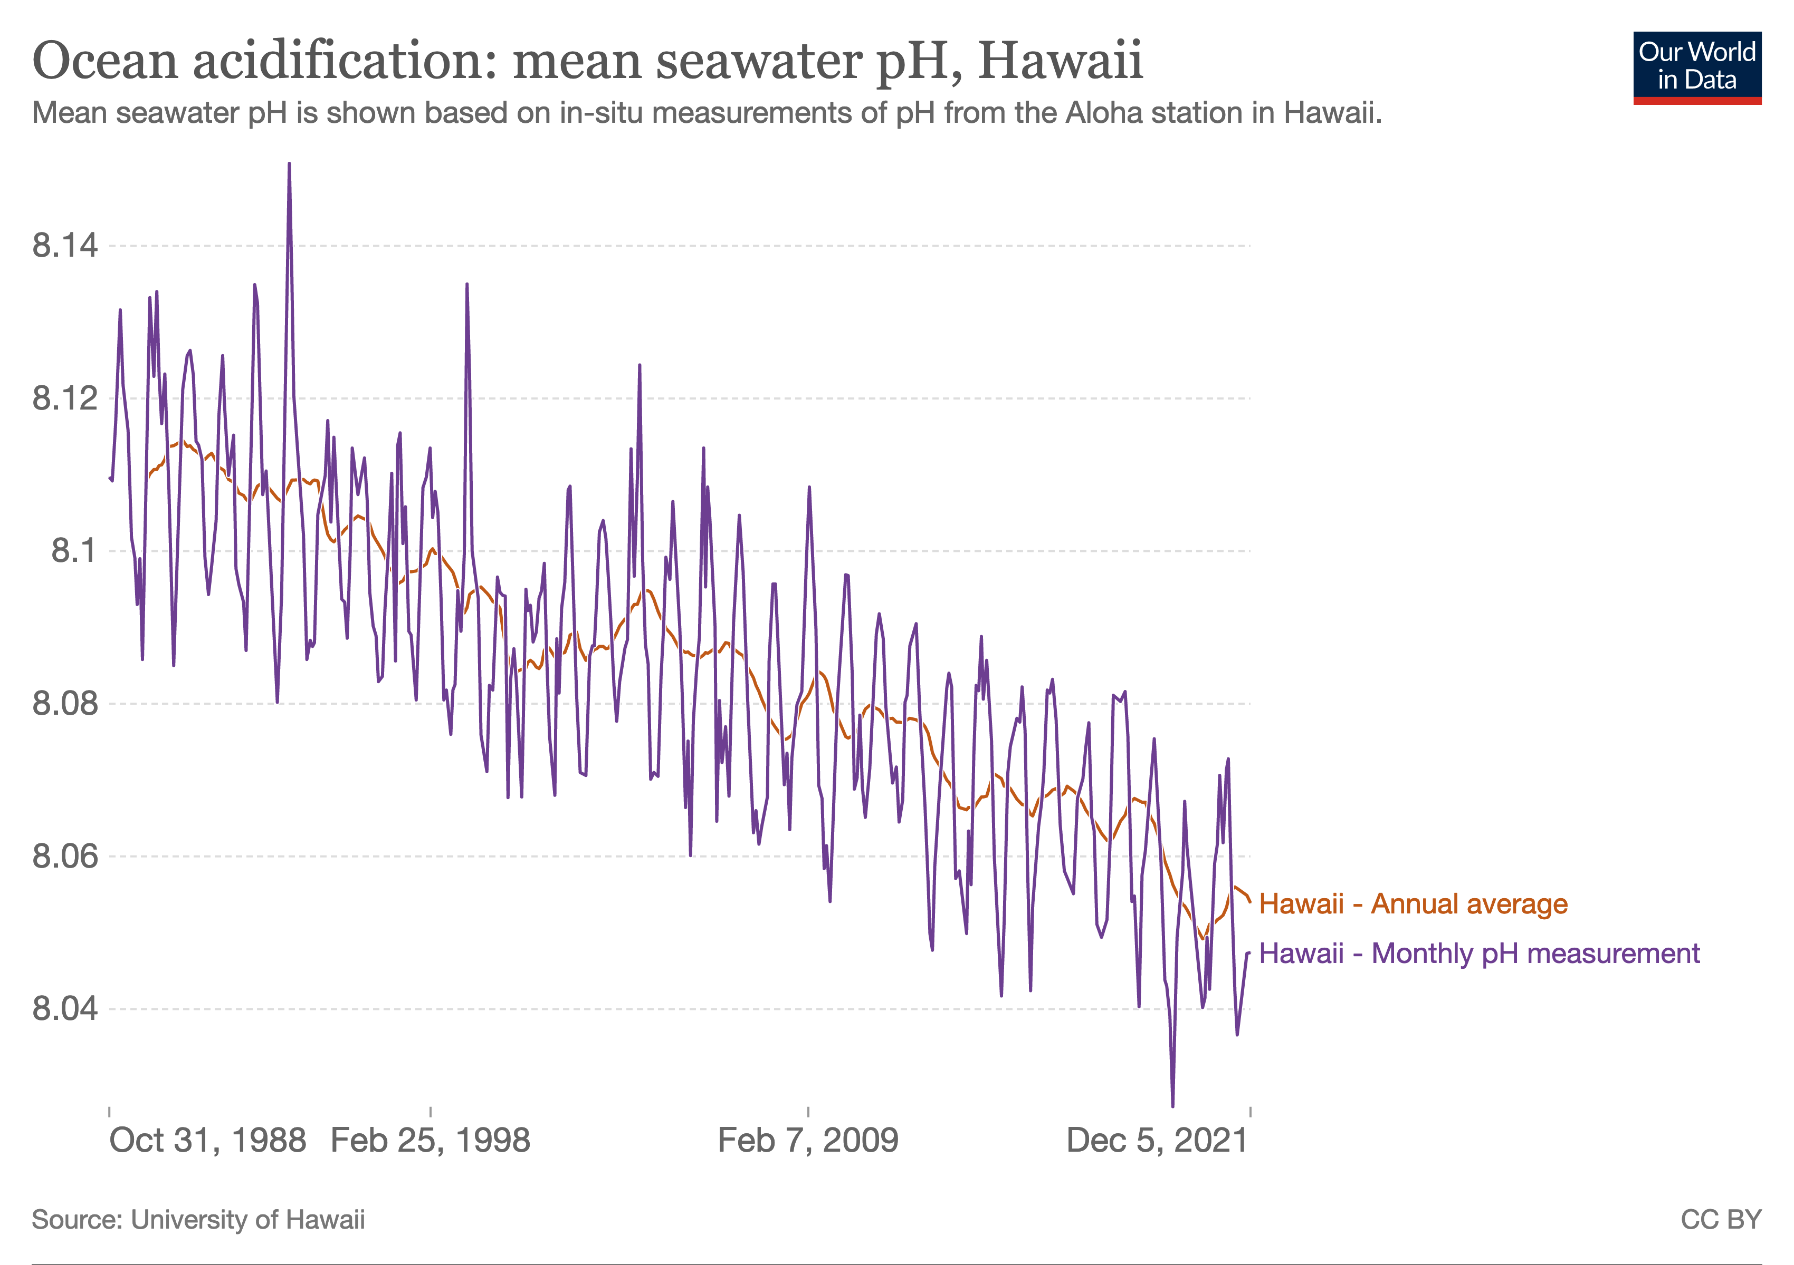

Slide 5
Other consequences of climate change
Global warming: occurring about ten times as rapidly as after each of the eight Ice Ages that have occurred over the last 800,000 years
Extreme weather events
More earthquakes
Fewer deaths from ‘non-optimal temperatures’: a little over five million human deaths each year = about 9.5% of all deaths. About 8.5% of all deaths are cold-related and 1% are heat-related.
An increase in water shortages
More flooding and the possible disappearance of some island nations
A rise in animal-borne diseases
? more wars and political instability over water and food shortages

Slide 6
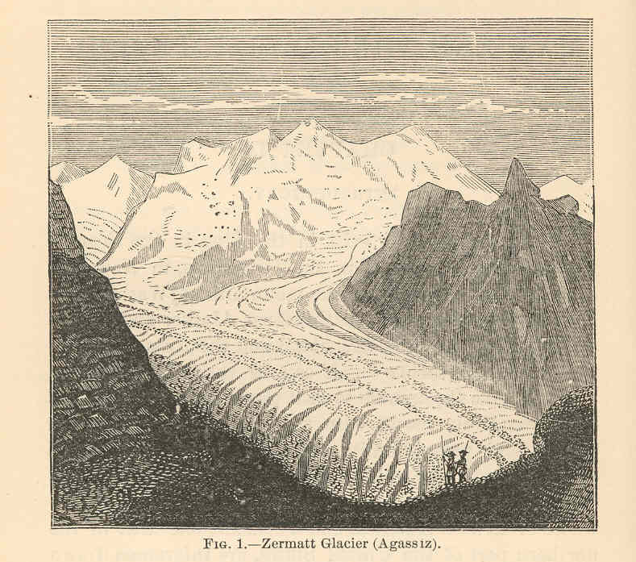
Notes:
https://commons.wikimedia.org/wiki/File:FMIB_39488_Zermatt_Glacier_(Agassiz).jpeg; 1892

Slide 7
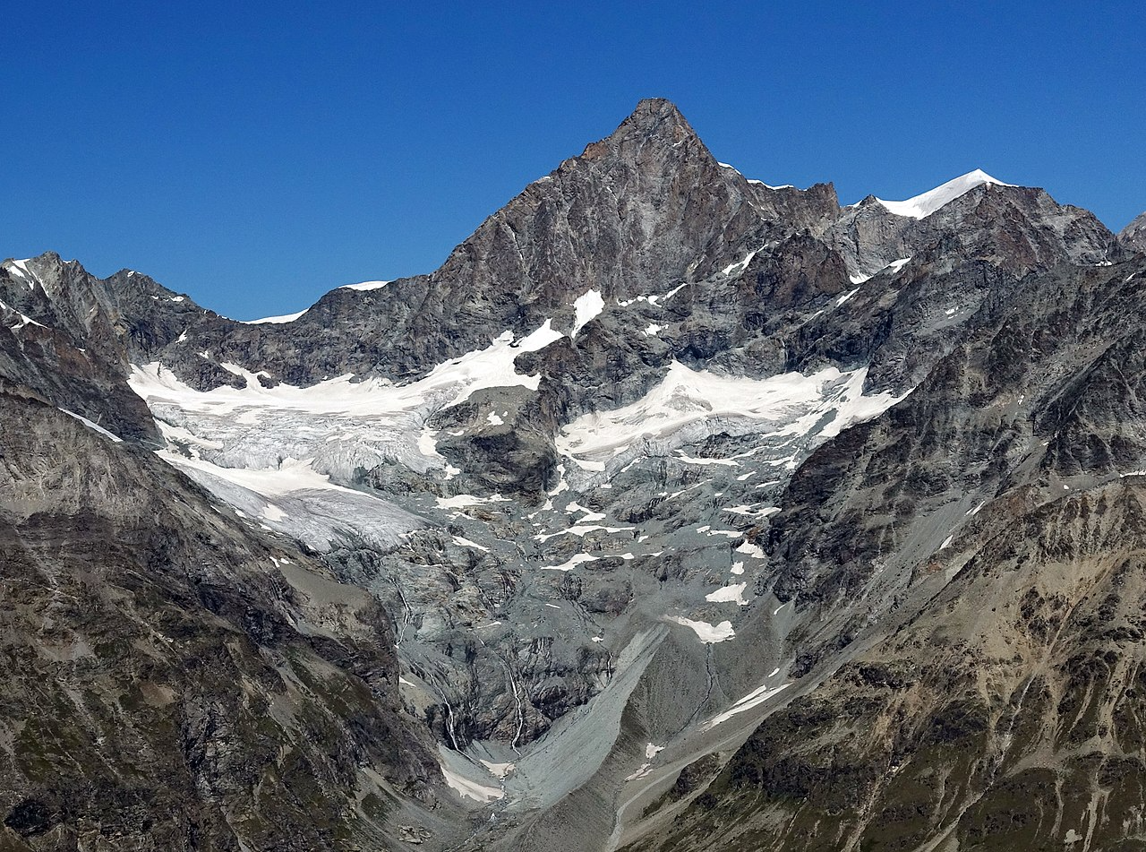
Notes:
https://commons.wikimedia.org/wiki/File:Glacier_in_Zermatt_2.jpg 2019. Swiss glaciers lost 52% of their volume between 1931 and 2016, and a further 12% by 2022: https://tc.copernicus.org/articles/16/3249/2022/tc-16-3249-2022.pdf

Slide 8
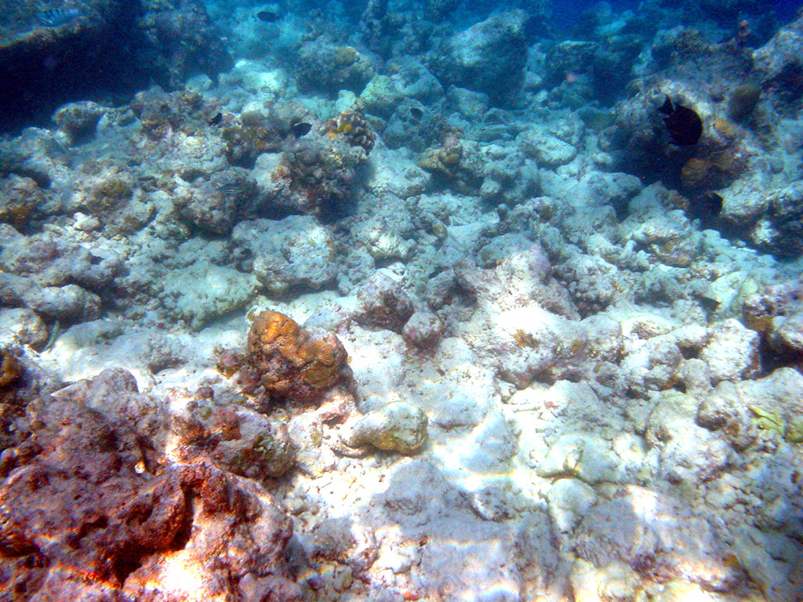
The consequences of climate change for other species are far greater
“Climate change is the greatest
global threat to coral reef
ecosystems”
(National Ocean Service, 2023)

Slide 9
It’s not just climate change – biodiversity loss and the sixth mass extinction
A mass extinction is when 75% or more of all species are thought to have gone extinct over what is to a geologist a relatively short period (typically less than two million years!).
The end of the Ordovician (about 443 million years ago). An estimated 85% of all species went extinct, probably as a result of global cooling, reduced sea levels and ocean anoxia.
The Late Devonian (about 360 million years ago). An estimated 75% of all species went extinct as the rapid growth of land plants caused a substantial fall in atmospheric CO₂ concentrations with resulting global cooling.

Slide 10
The sixth mass extinction (cont.)
The end of the Permian (about 250 million years ago) when fully 96% of all species are thought to have gone extinct. The cause was intense volcanic activity that raised atmospheric CO₂ and H₂S levels, resulting in global warming, ocean acidification and acid rain.
The end of the Triassic (about 200 million years ago). An estimated 75% of all species went extinct when underwater volcanic activity caused global warming and major changes in the oceans.
The Cretaceous ended (about 66 million years ago) with an asteroid impact in present-day Yucatán, Mexico. This caused an estimated 76% of all species to go extinct as rapid cooling killed many species, including all animals with a mass of more than about 25 kg.

Slide 11
Are we living through the sixth mass extinction?
Not yet
Molluscs: since about 1500 CE, possibly as many as 7.5–13% (150,000–260,000) of all ~two million known species have already gone extinct (Cowie et al., 2022).
“Even under our assumptions, which would tend to minimize evidence of an incipient mass extinction, the average rate of vertebrate species loss over the last century is up to 100 times higher than the background rate.” (Ceballos et al., 2015: 1)
Current extinction rates for terrestrial plants and animals “are 1,000 times higher than natural background rates of extinction and future rates are likely to be 10,000 times higher.” (De Vos et al., 2015: 452)

Slide 12
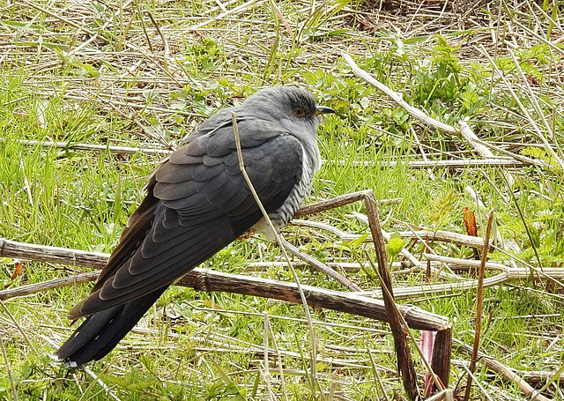
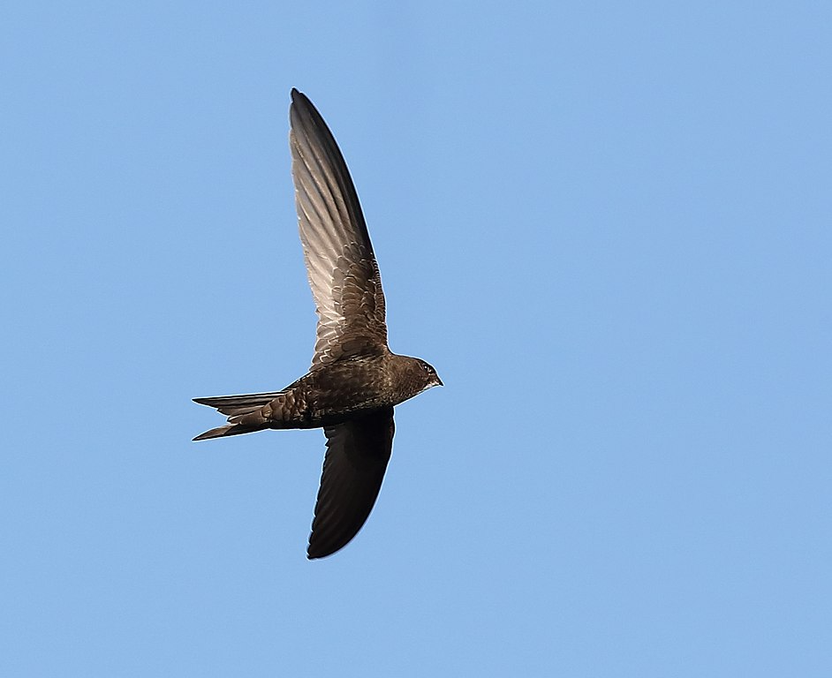
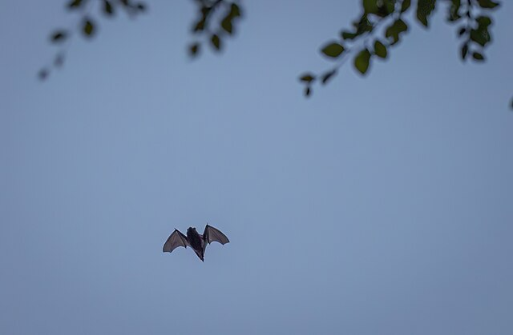
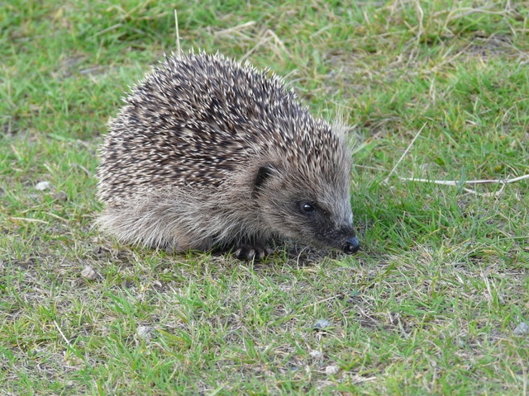
Notes:
https://commons.wikimedia.org/wiki/File:Gök_Common_Cuckoo_(20163877259).jpg; https://commons.wikimedia.org/w/index.php?search=swifts+apus&title=Special:MediaSearch&go=Go&type=image; https://commons.wikimedia.org/wiki/File:Zwergfledermaus_in_der_Dämmerung_Naturschutzgebiet_Frankfurter_Grüngürtel.jpg; https://commons.wikimedia.org/wiki/File:Young_Hedgehog_-_geograph.org.uk_-_2094188.jpg

Slide 13
The role of school science education
Powerful knowledge
  Michael Young
  Relationship to human flourishing
  “the main function of school … is to enable all students to acquire knowledge that takes them beyond their experience (Young, 2014: 10)
  Arguments against climate change:
    ‘The Earth’s climate is always changing and this is nothing to do with humans’
    ‘Computer models which predict the future climate are unreliable and based on a series of assumptions’
    ‘It’s all to do with the Sun – for example, there is a strong link between increased temperatures on Earth and the number of sunspots on the Sun’ (Royal Society, 2008)

Slide 14
The role of school science education (cont.)
The Nature of Science
  Now versus in 1989
  The importance of school science tackling issues to do with misinformation (Osborne et al., 2022)
  We need an education that helps students understand how scientists practise science, including the role of modelling in hypothesis testing and theory generation. This would help students to understand better whether the future of climate change is likely simply to be a linear progression from the present or entail tipping points, for example to ocean currents, in which there are sudden changes that can only be reversed over very long periods of time.

Slide 15
The role of school science education (cont.)
Interdisciplinarity within science
  Interactions between biology, chemistry and physics
  The position of Earth Science

Slide 16
Changes to the Science National Curriculum
The National Curriculum Review Science Working Group (2011-13)
Different visions for science education: Vision I, Vision II, Vision III
Responding to student interest
Student knowledge, student engagement, student skills, student action
The role of research in this
The value of consensus within the science education community

Slide 17
Other subjects
UCL Centre for Climate Change and Sustainability Education
  Professional development modules for teachers in geography and history (at both primary and secondary level) that can be accessed free on-line
Geography
History

Slide 18
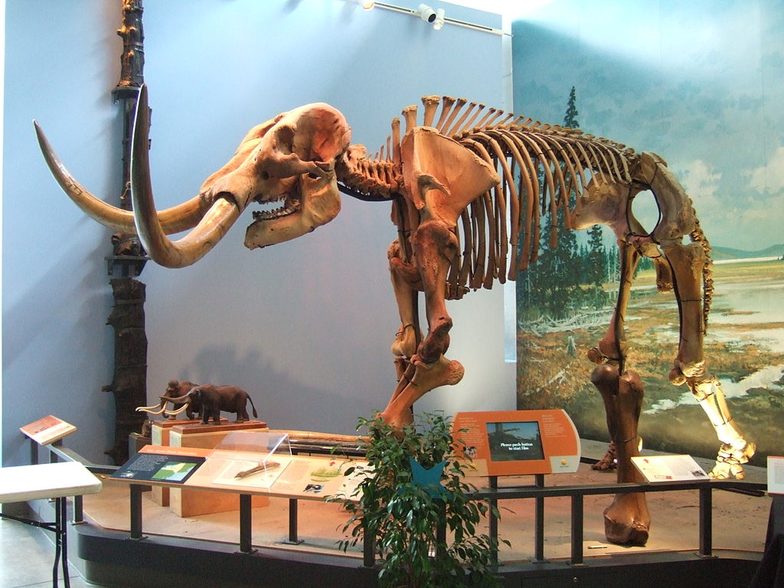
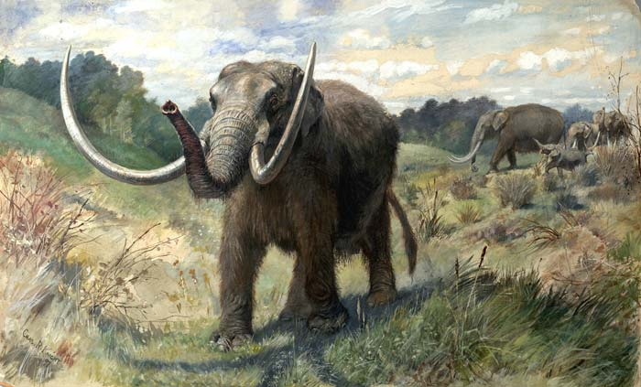
The megafaunal extinctions
Notes:
https://commons.wikimedia.org/wiki/File:Mammut_skeleton_Museum_of_the_Earth.jpg;
https://commons.wikimedia.org/wiki/File:Knight_Mastodon.jpg

Slide 19
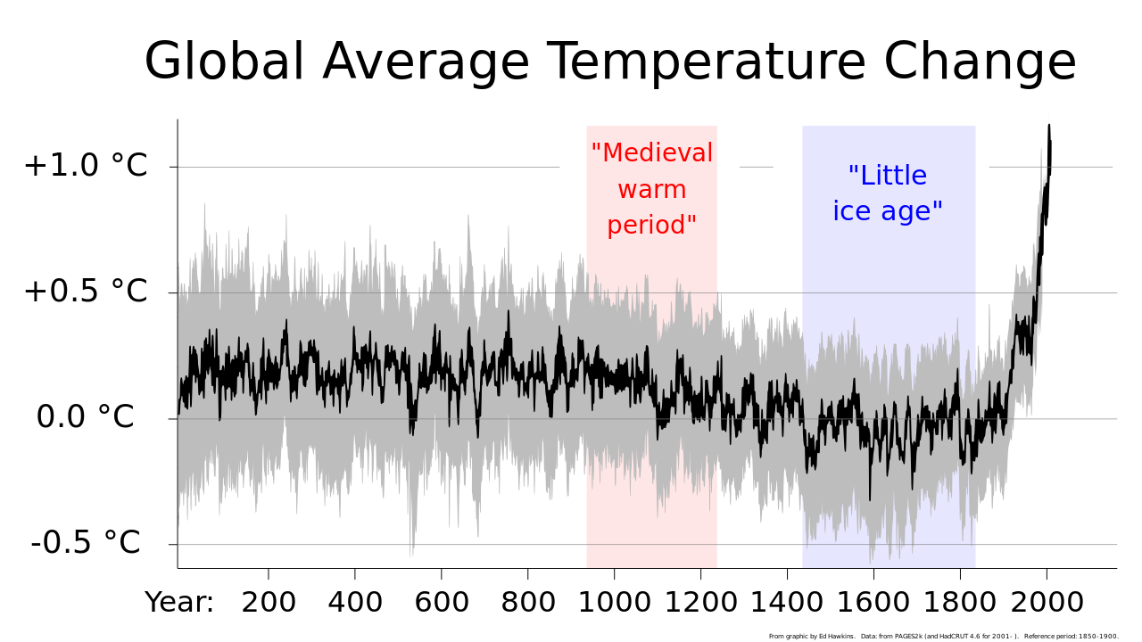
The Little Ice Age

Slide 20
Ethics, values and actions (cont.)
“Practical opportunities to participate in activities to increase climate resilience, reduce carbon impact and enhance biodiversity will enable children and young people to translate knowledge into positive action to improve their local communities, their country and the planet.” (DfE, 2023)
“It would not be appropriate for a teacher to suggest that pupils join a certain campaigning group or engage in specific political activity, for example, an upcoming protest.” (DfE, 2022)

Slide 21
Questions and Comments (after responses by Judith Hillier and Steve Puttick)
Thank you!
m.reiss@ucl.ac.uk

