Slide 1

A new vision for science in the national curriculum: how should the curriculum deal with climate change?
Judith Hillier – Associate Professor of Science Education (Physics)

Slide 2
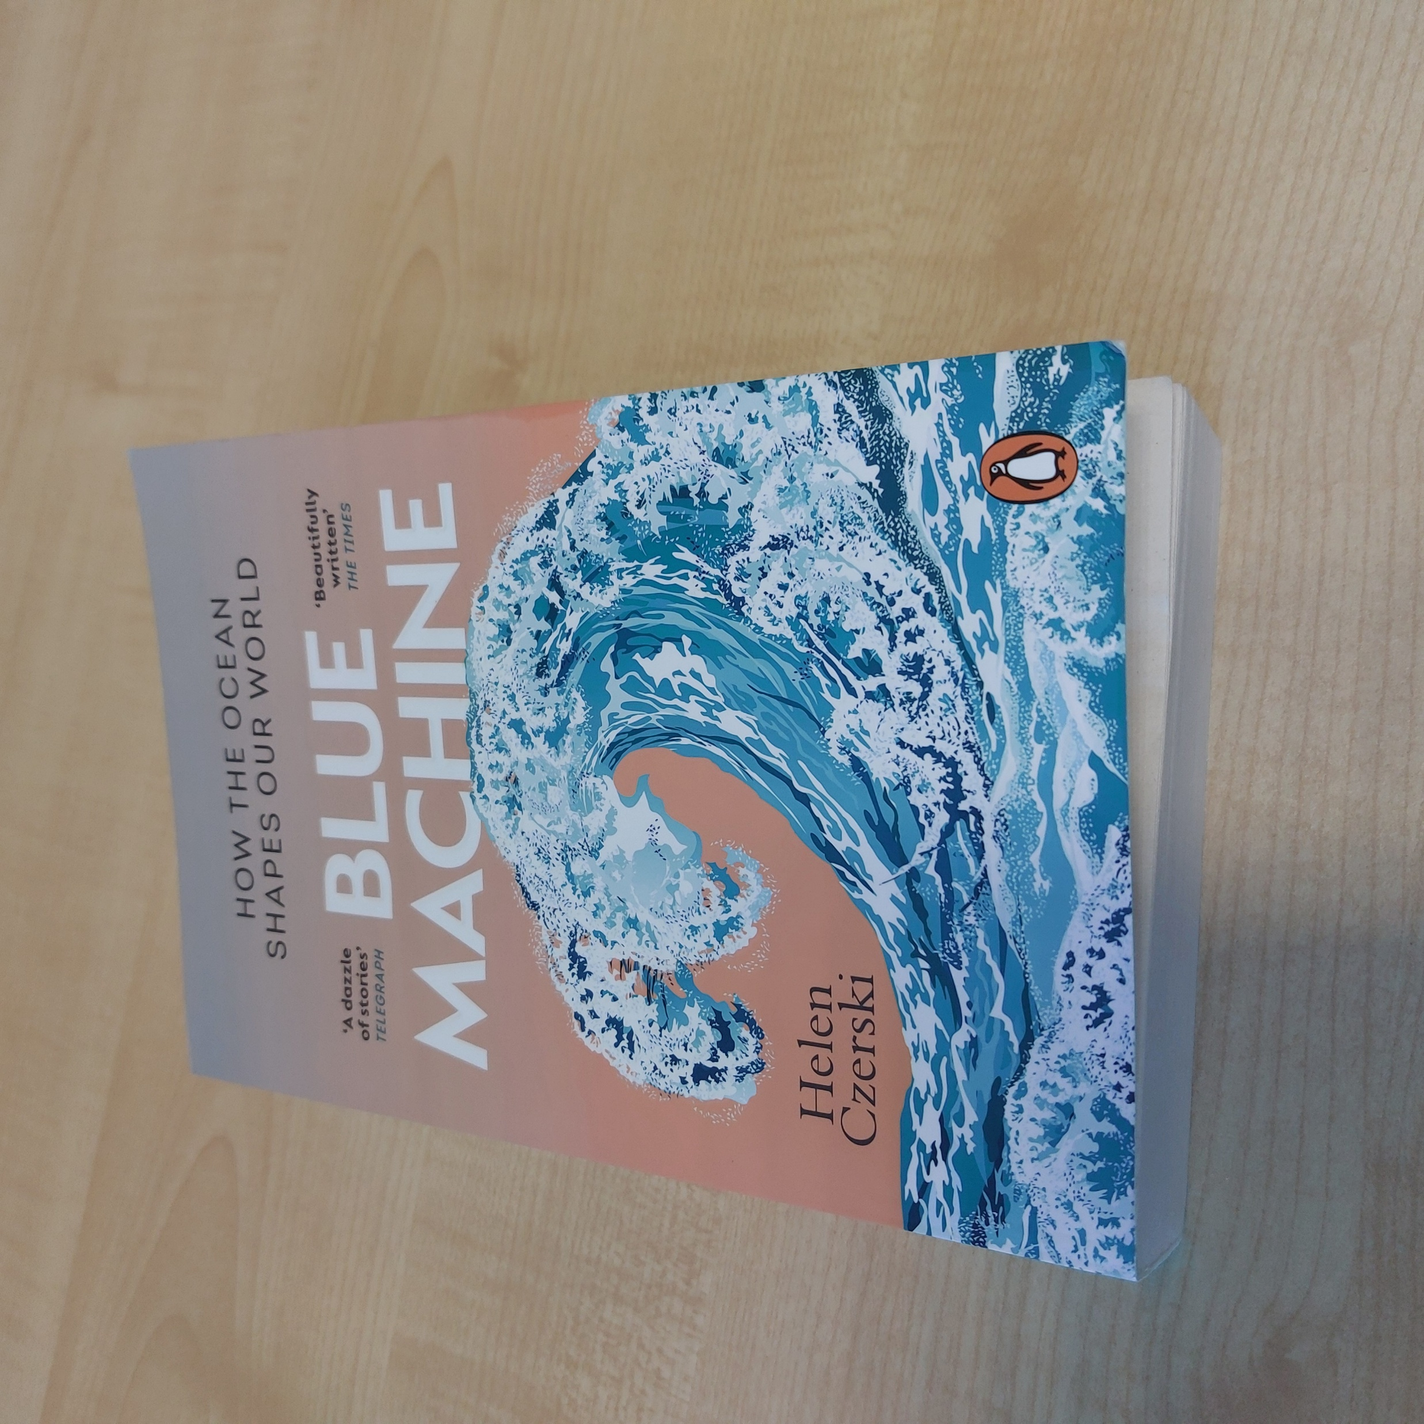
Values
“There is often a perception that ‘following the science’ should be the primary way to get things done
Leadership comes from a clear statement of values, followed by using the best available information about how to act according to those values
We should talk explicitly about values, because that’s what tells us what we prioritise and what direction we want our society to head in
Once you’ve made a decision about your values, then science, and science education, has a contribution to make, because it gives us the best understanding of how to get there”
Helen Czerki (2023) Blue Machine, p.381
Notes:
Read
“I’m a scientist and I’m telling you that it’s not, for the simple reason that science does not lead.
2. We have to decide for ourselves and our communities what we care about. How do we prioritise social justice, economic gains, individual freedom, community values, and the rest? The answer might be different in different situations, and they are often hard questions. They have nuance, and they may depend on things that depend on other things.

Slide 3

What are the values underpinning our curriculum?
Transactional view – people, plants, animals, minerals are commodities to be traded, exploited, used without thought for the future
Learning is a transactional process
“I used to think that teachers were required to be politically neutral – now I see that the very act of having a curriculum is a political position“
Former PGCE intern

Slide 4
“But just remember this. One Eva Smith has gone – but there are millions and millions and millions of Eva Smiths and John Smiths left with us, with their lives, their hopes and fears, their suffering and a chance of happiness, all intertwined with our lives and what we think and say and do.
We don’t live alone. We are members of one body. We are responsible for each other. And I tell you that the time will soon come when, if men will not learn that lesson, then they will be taught in fire and blood and anguish. Good night.”
Notes:
Quote from the inspector’s last speech, from An Inspector Calls by J B Priestley

Slide 5
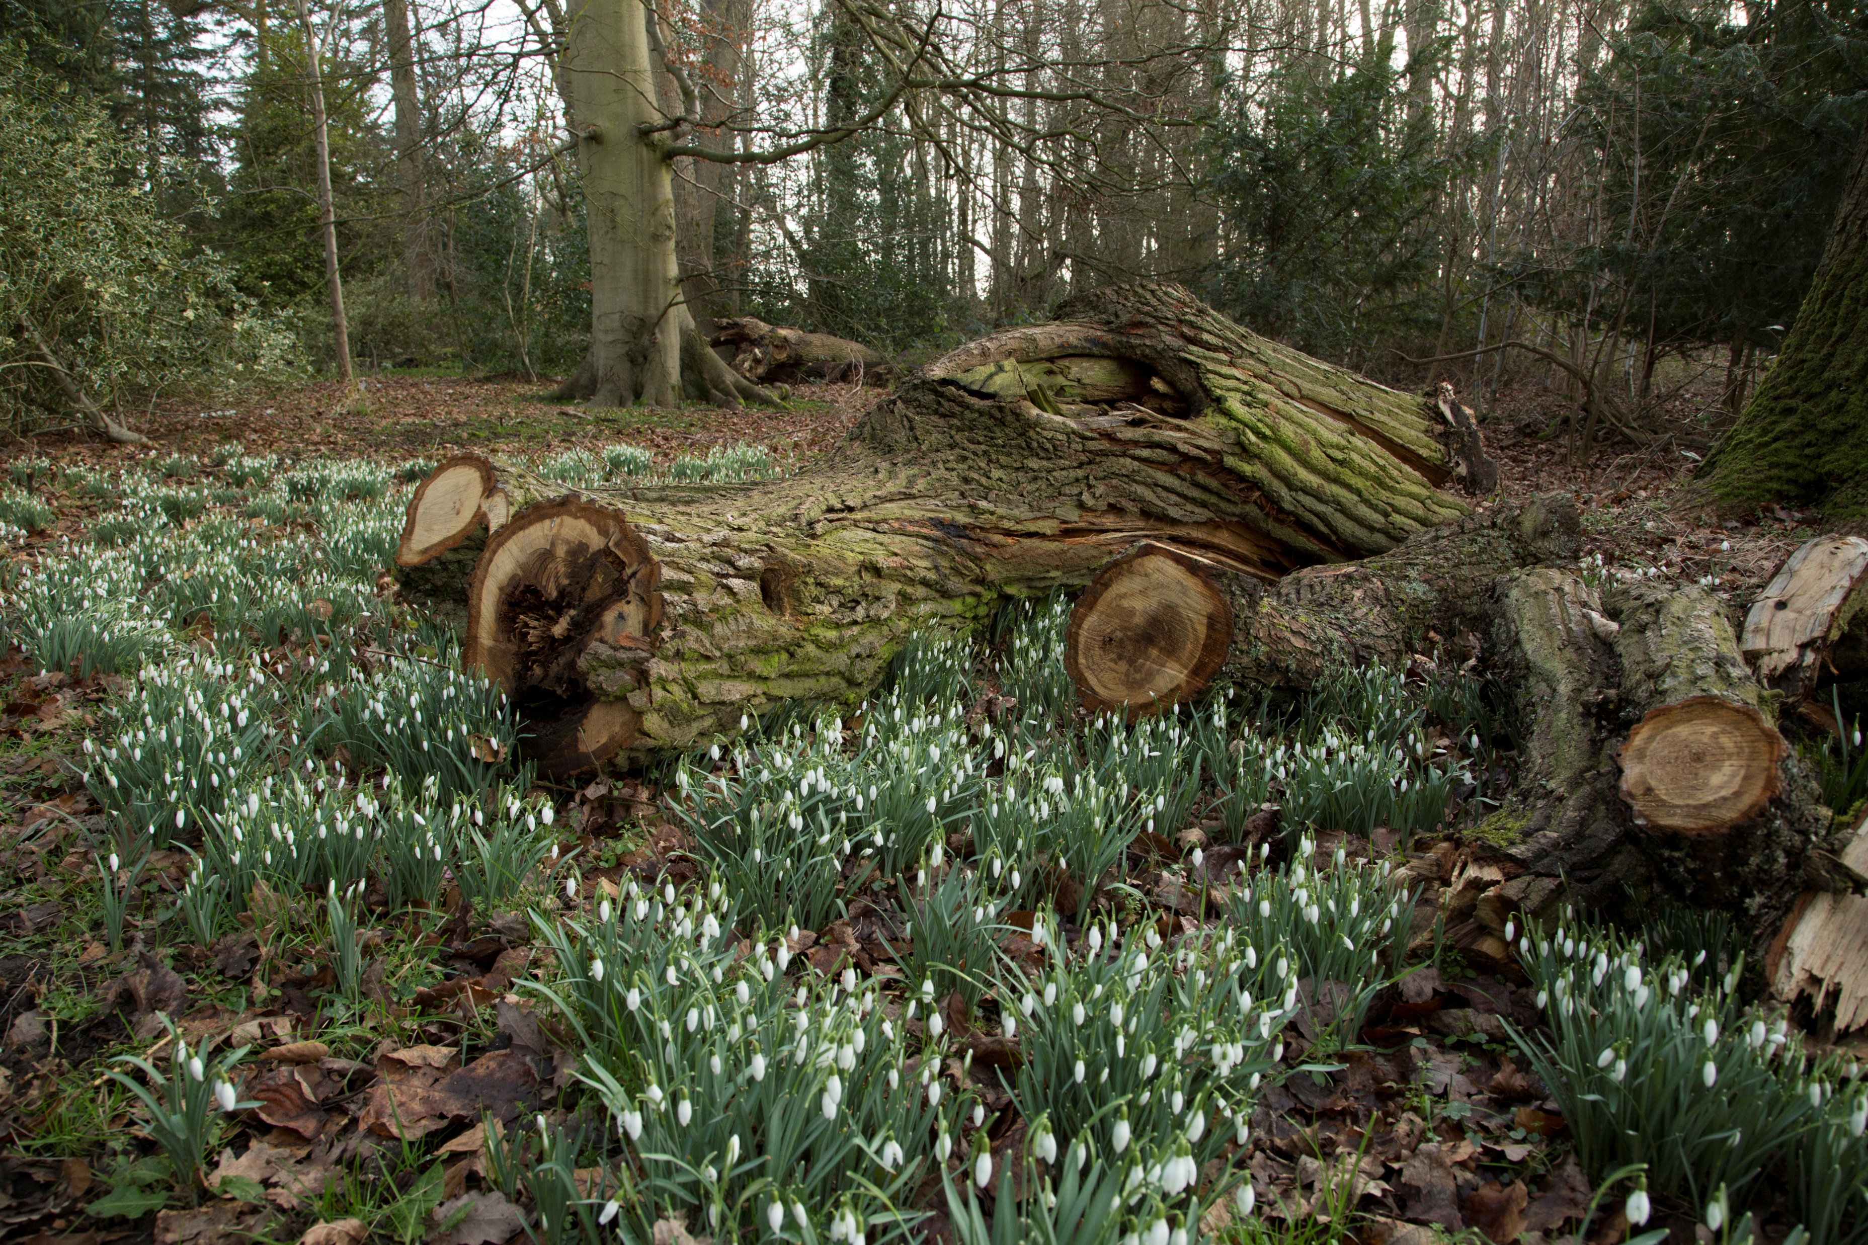
What are the values underpinning our curriculum?
Recognising that we are part of a planetary ecosystem on which our species depends for survival
Importance of curating the resources available in a sustainable way
Learning is about flourishing

Slide 6
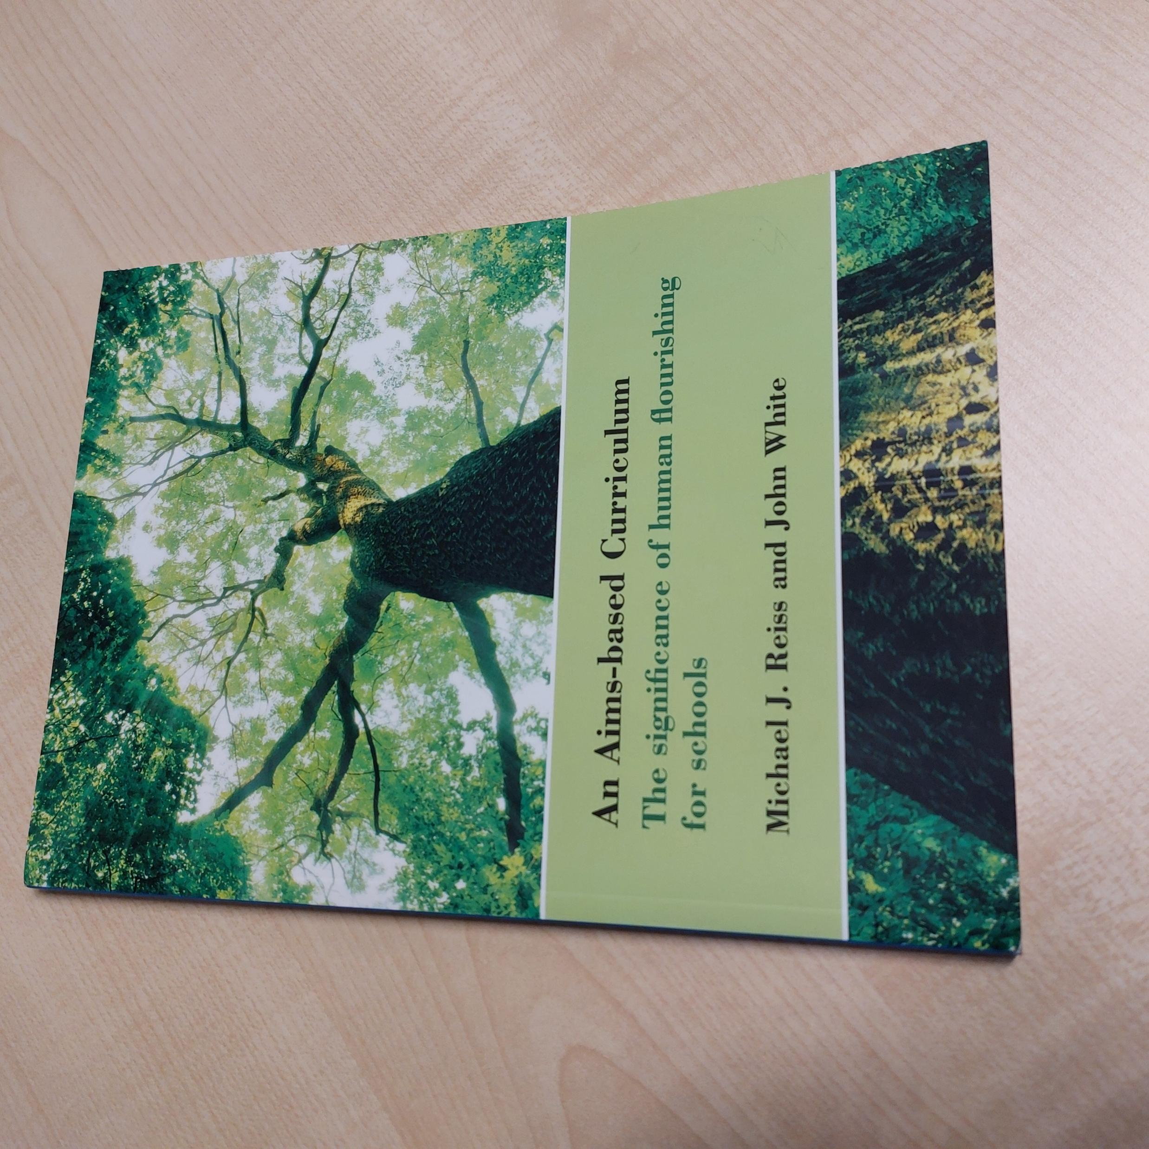
Aims of schools
“Helping every student to form a broad background of understanding
Equipping every student to lead a personally flourishing life
Equipping every student to help others to lead personally flourishing lives
Michael Reiss and John White (2013), An Aims-based Curriculum: the significance of human flourishing for schools, p.11

Slide 7
Current science National Curriculum for England
Searching for “climate”
  KS3: Students should be taught about the production of carbon dioxide by human activity and the impact on climate.
  KS4: Students should be taught about the evidence, and uncertainties in evidence, for additional anthropogenic causes of climate change and
  potential effects of, and mitigation of, increased levels of carbon dioxide and methane on the Earth’s climate
Searching for “sustain*”
  Zero results

Slide 8
A vision for science education?
Students, teachers and schools
Recognise that we are part of a planetary ecosystem on which our species depends for survival
Understand the importance of curating the resources available in a sustainable way
Empowered to advocate for change
Able to choose to live in a sustainable and flourishing way
Curriculum
Assessment
Pedagogies

