Slide 1
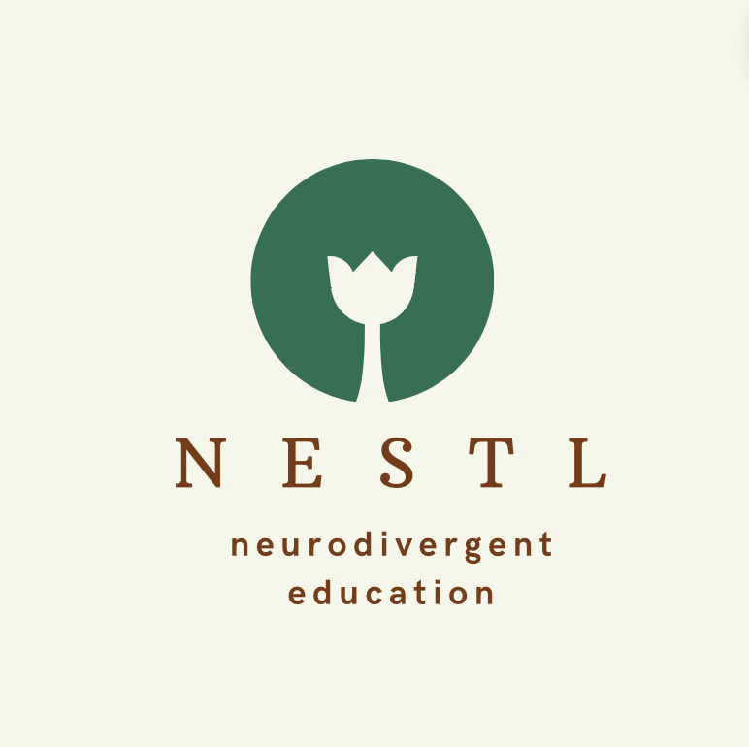
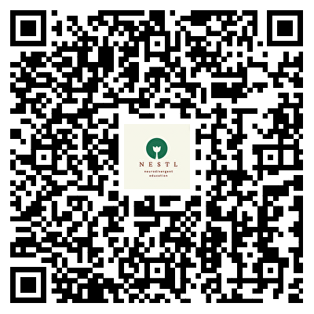
Neurodivergent Education for Students, Teaching & Learning (NESTL) Toolkit
Individual
Communal
Co-Created with Neurodivergent Students and Staff, the NESTL Toolkit offers -
Framework for Neurodivergent-inclusive Teaching and Learning
Practical suggestions, with examples, quotes, case studies, checklists, and interactive activities
Myth-busting around neurodivergence in higher education
Curated lists of resources for further exploration
Teaching Practices,
Space, Materials
Awareness, Understanding, Reflections
Assessment,
Feedback
Adjustments, Support
Sectoral
Institutional
Scan the QR code to access the NESTL Toolkit
Framework for Neurodivergent-Inclusive Teaching and Learning
NESTL Project Team: Xin Xu, Laura Seymour, Cressida Ryan, Siân Grønlie, Georgia Lin, Hanrui Li
Notes:
Notes: If you're running training sessions or workshops for educators and find the NESTL Toolkit helpful, please feel free to use this slide to introduce or share information about the toolkit. You're welcome to adapt it with appropriate attribution.

